Slide 1
Convolutional Codes

Slide 2
Targets today
Why to apply convolutional coding?
Defining convolutional codes
Practical encoding circuits
Defining quality of convolutional codes
Decoding principles
Viterbi decoding

Slide 3
Convolutional encoding
input bit
k bits
(n,k,L)
encoder
n bits
message bits
encoded bits
n(L+1) output bits
Convolutional codes are applied in applications that require good performance with low implementation complexity. They operate on code streams (not in blocks)
Convolution codes have memory that utilizes previous bits to encode or decode following bits (block codes are memoryless)
Convolutional codes are denoted by (n,k,L), where L is code (or encoder) Memory depth (number of register stages)
Constraint length C=n(L+1) is defined as the number of encoded bits a message bit can influence to
Convolutional codes achieve good performance by expanding their memory depth

Slide 4
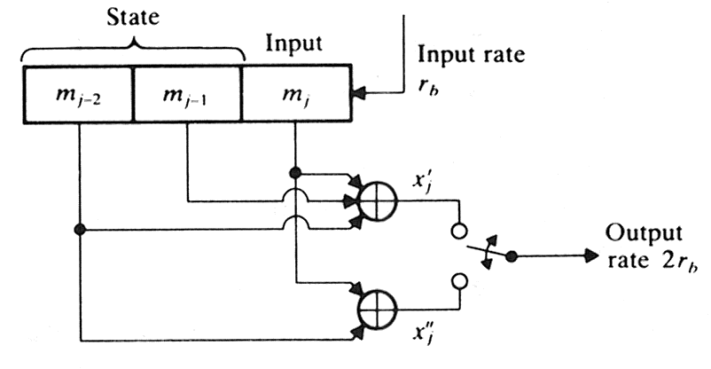
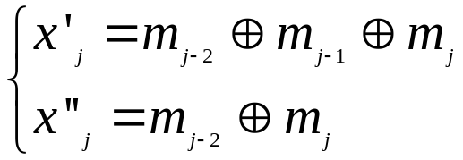

Example: Convolutional encoder, k = 1, n = 2
memory
depth L
= number
of states
(n,k,L) = (2,1,2) encoder
Convolutional encoder is a finite state machine (FSM) processing information bits in a serial manner
Thus the generated code is a function of input and the state of the FSM
In this (n,k,L) = (2,1,2) encoder each message bit influences a span of C= n(L+1)=6 successive output bits = constraint length C
Thus, for generation of n-bit output, we require in this example n shift registers in k = 1 convolutional encoder

Slide 5
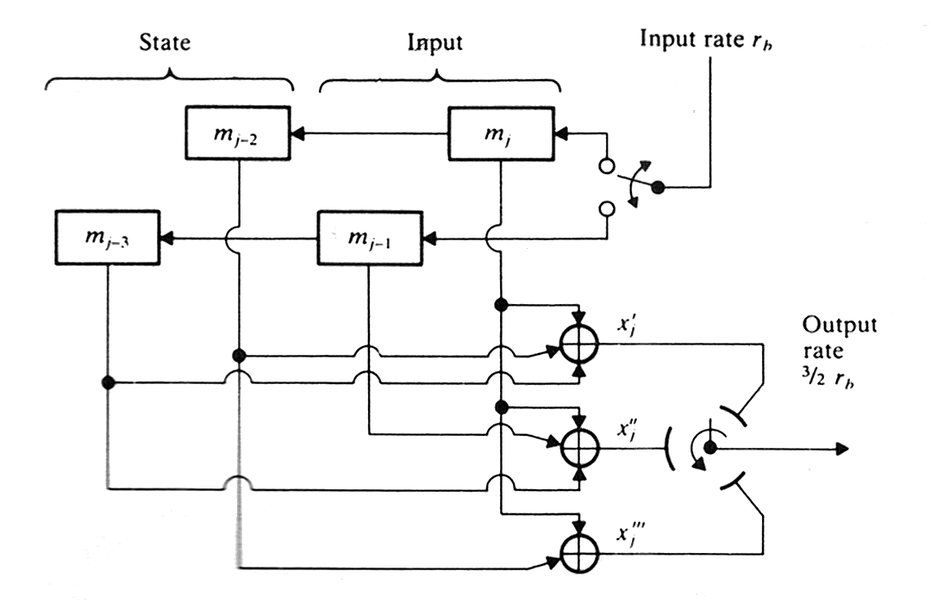



Example: (n,k,L)=(3,2,1) Convolutional encoder
After each new block of k input bits follows a transition into new state
Hence, from each input state transition, 2^{k} different output states may follow
Each message bit influences a span of C = n(L+1) = 3(1+1) = 6
successive output bits

Slide 6

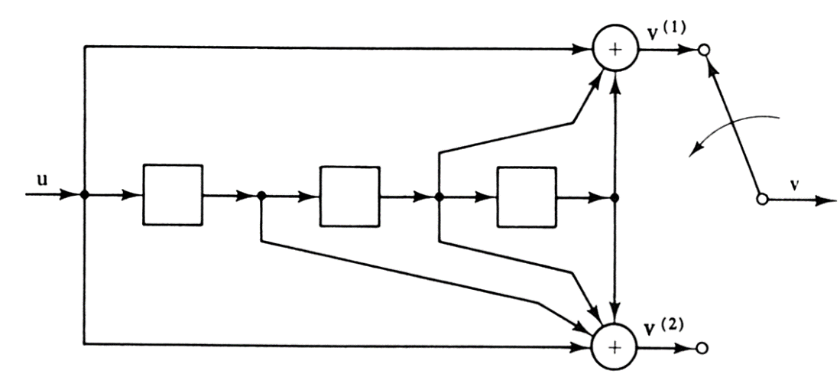





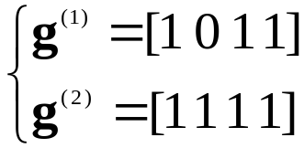
Generator sequences
k bits
(n,k,L)
encoder
n bits
(n,k,L) Convolutional code can be described by the generator sequences
that are the impulse responses for each coder n output branches:
Generator sequences specify convolutional code completely by the associated generator matrix
Encoded convolution code is produced by matrix multiplication of the input and the generator matrix
Note that the generator sequence length
exceeds register depth always by 1

Slide 7


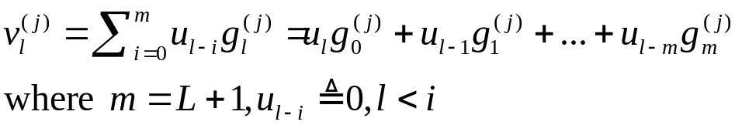
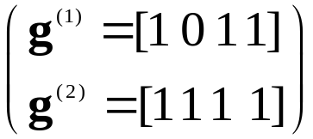
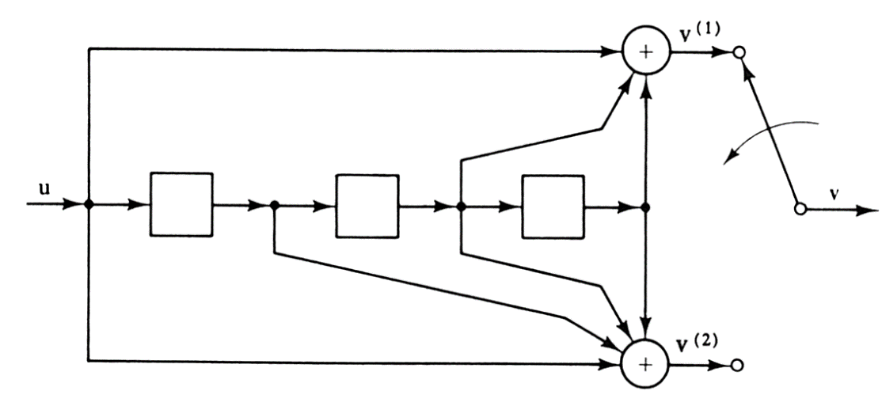



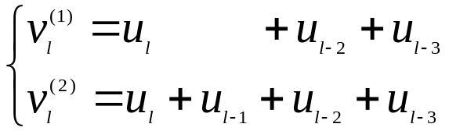



Convolution point of view in encoding and generator matrix
Encoder outputs are formed by modulo-2
discrete convolutions:
where u is the information sequence:
Therefore, the l:th bit of the j:th output branch is*
Hence, for this circuit the following equations result, (assume: )
input bit
n(L+1) output bits
j branches
encoder output:
*note that u is reversed in time as in the definition of convolution top right

Slide 8
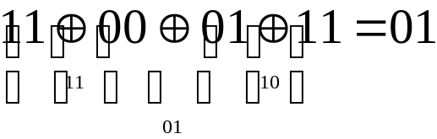
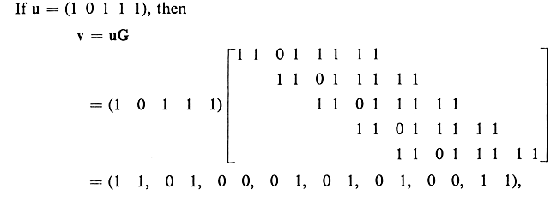



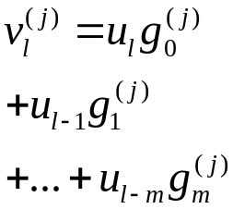

Example: Using generator matrix
Verify that you can obtain the result shown!

Slide 9
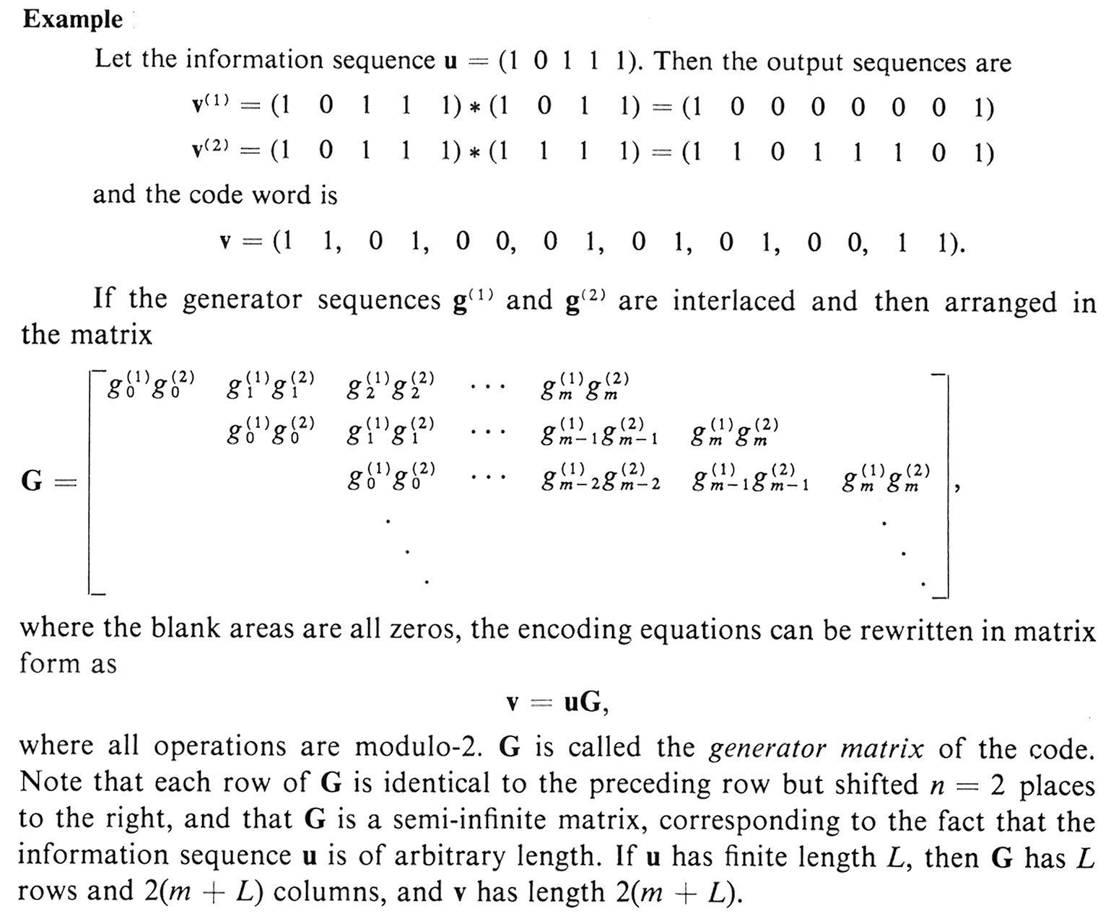
S.Lin, D.J. Costello: Error Control Coding, II ed, p. 456

Slide 10
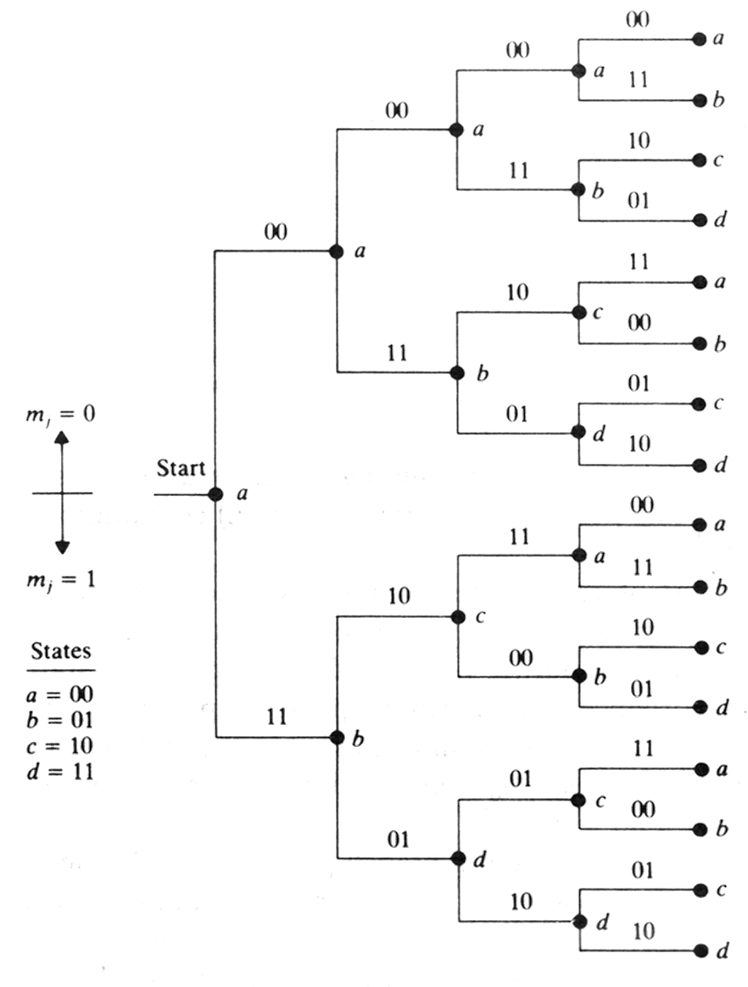
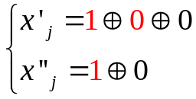
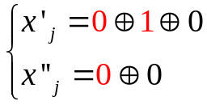

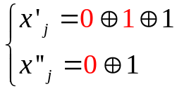
Representing convolutional codes: Code tree
Number of braches
deviating from each node
equals 2^{k}
(n,k,L) = (2,1,2) encoder
This tells how one input bit
is transformed into two output bits
(initially register is all zero)

Slide 11
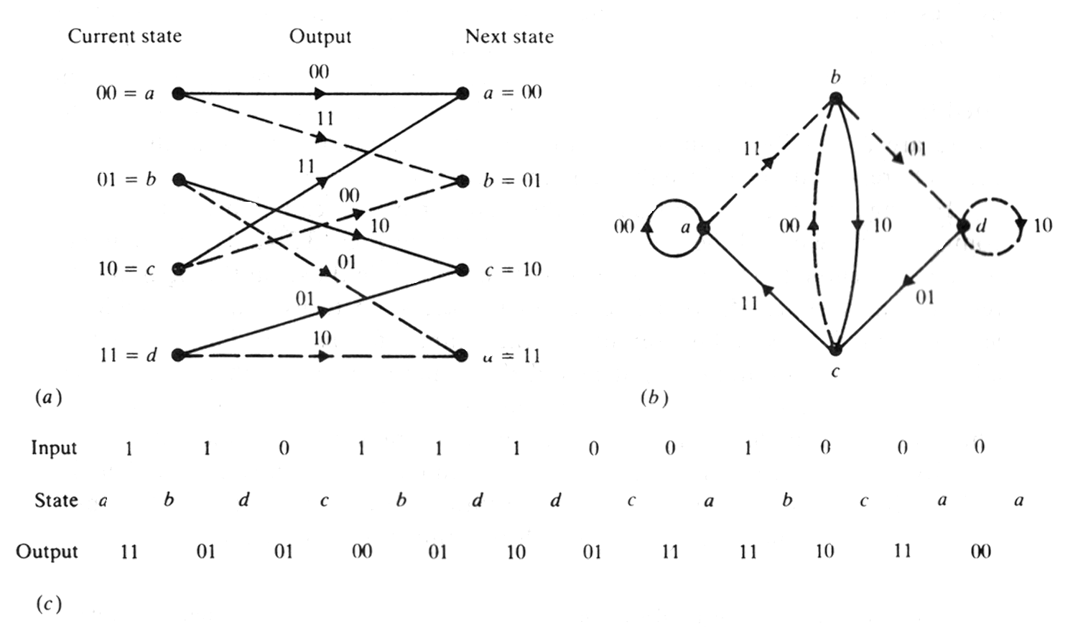
Representing convolutional codes compactly:
code trellis and state diagram
Input state ‘1’
indicated by dashed line
State diagram
Code trellis
Shift register states

Slide 12
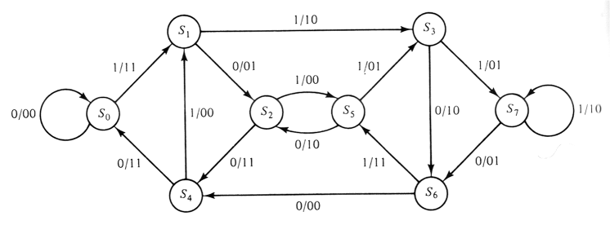
Inspecting state diagram: Structural properties of convolutional codes
Each new block of k input bits causes a transition into new state
Hence there are 2^{k} branches leaving each state
Assuming encoder zero initial state, encoded word for any input of k bits can thus be obtained. For instance, below for u=(1 1 1 0 1), encoded word v=(1 1, 1 0, 0 1, 0 1, 1 1, 1 0, 1 1, 1 1) is produced:
Verify that you obtain the same result!
Input state
- encoder state diagram for (n,k,L)=(2,1,2) code
- note that the number of states is 8 = 2^{L+1} => L = 2 (two state bits)

Slide 13

Code weight, path gain, and generating function
The state diagram can be modified to yield information on code distance properties (= tells how good the code is to detect or correct errors)
Rules (example on the next slide):
  (1) Split S₀ into initial and final state, remove self-loop
  (2) Label each branch by the branch gain X^{i.} Here i is the weight* of the n encoded bits on that branch
  (3) Each path connecting the initial state and the final state represents a nonzero code word that diverges and re-emerges with S₀ only once
The path gain is the product of the branch gains along a path, and the weight of the associated code word is the power of X in the path gain
Code weigh distribution is obtained by using a weighted gain formula to compute its generating function (input-output equation)
where A_{i} is the number of encoded words of weight i
*In linear codes, weight is the number of ‘1’:s in the encoder output

Slide 14
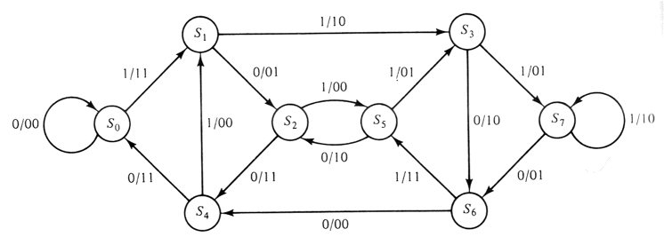
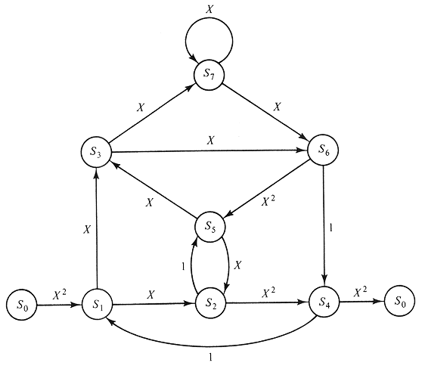
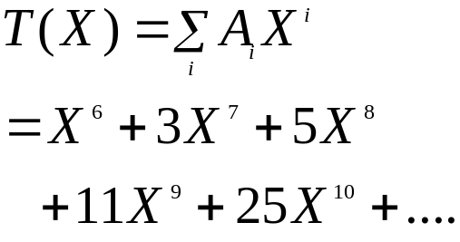
branch
gain
weight: 2
weight: 1
Example: The path representing the state
sequence S₀S₁S₃S₇S₆S₅S₂S₄S₀ has the
path gain X²X¹X¹X¹X²X¹X²X²=X¹²
and the corresponding code word
has the weight of 12
Where does these terms come from?

Slide 15




Distance properties of convolutional codes
Code strength is measured by the minimum free distance:
where v’ and v’’ are the encoded words corresponding information sequences u’ and u’’. Code can correct up to errors.
The minimum free distance d_{free} denotes:
    The minimum weight of all the paths in the state diagram that diverge from and remerge with the all-zero state S₀
    The lowest power of the code-generating function T(X)
Code gain*:
* for derivation, see Carlson’s, p. 583

Slide 16

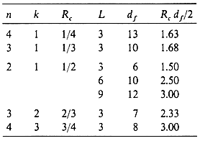
Coding gain for some selected convolutional codes
Here is a table of some selected convolutional codes and their
code gains R_{C}d_{free} /2 expressed for hard decoding also by

Slide 17



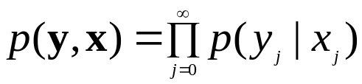

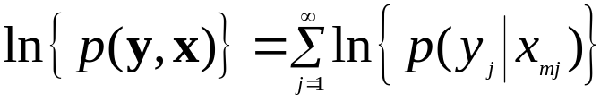
Decoding of convolutional codes
Maximum likelihood decoding of convolutional codes means finding the code branch in the code trellis that was most likely transmitted
Therefore maximum likelihood decoding is based on calculating code Hamming distances for each branch potentially forming encoded word
Assume that the information symbols applied into an AWGN channel are equally alike and independent
Let’s denote by x encoded symbols (no errors) and by y received (potentially erroneous) symbols:
Probability to decode the symbols is then
The most likely path through the trellis will maximize this metric.
Often ln() is taken from both sides, because probabilities are often
small numbers, yielding:
(note this corresponds equavalently also the smallest Hamming distance)
received code:
Decoder
(=distance
calculation)
non -
erroneous code:
bit
decisions

Slide 18
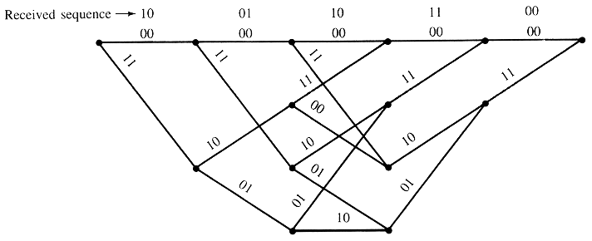
Example of exhaustive maximal likelihood detection
Assume a three bit message is transmitted and encoded by (2,1,2) convolutional encoder. To clear the decoder, two zero-bits are appended after message. Thus 5 bits are encoded resulting 10 bits of code. Assume channel error probability is p = 0.1. After the channel 10,01,10,11,00 is produced (including some errors). What comes after the decoder, e.g. what was most likely the transmitted code and what were the respective message bits?
a
b
states
c
decoder outputs
if this path is selected
d

Slide 19
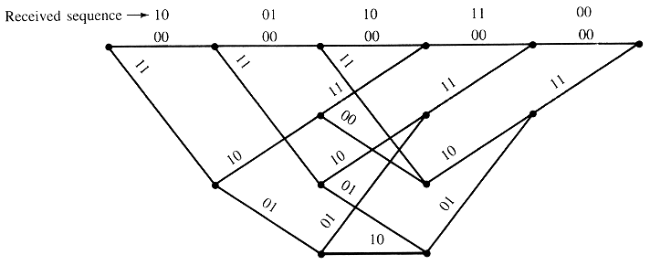
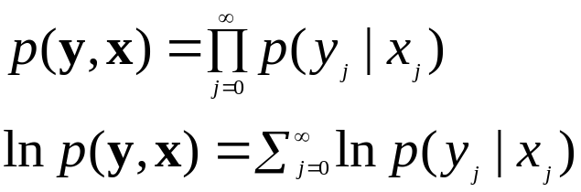
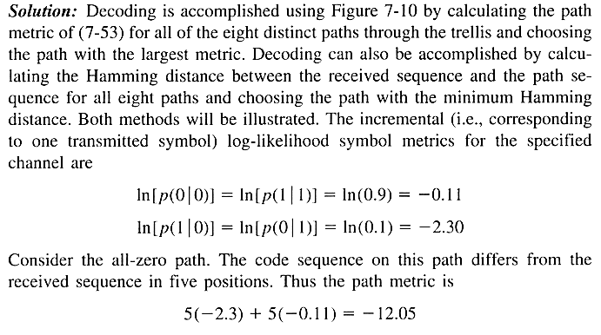
weight for prob. to
receive bit in-error
errors
correct

Slide 20
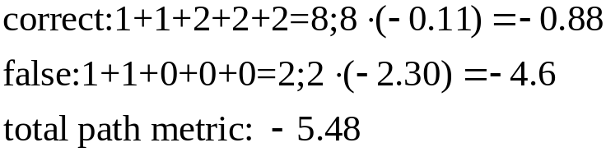
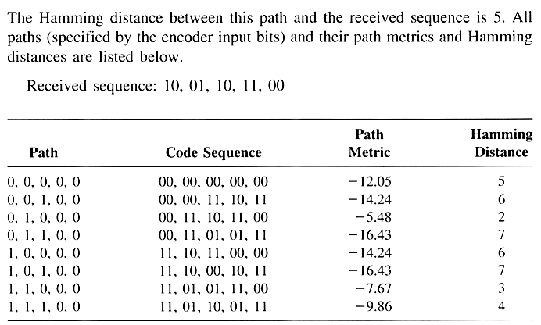
The largest metric, verify
that you get the same result!
Note also the Hamming distances!

Slide 21
The Viterbi algorithm
Problem of optimum decoding is to find the minimum distance path from the initial state back to the initial state (below from S₀ to S₀). The minimum distance is one of the sums of all path metrics from S₀ to S₀
Exhaustive maximum likelihood
method must search all the paths
in phase trellis (2^{k} paths emerging/
entering from 2 ^{L+1} states for
an (n,k,L) code)
The Viterbi algorithm gets
improvement in computational
efficiency via concentrating into
survivor paths of the trellis

Slide 22
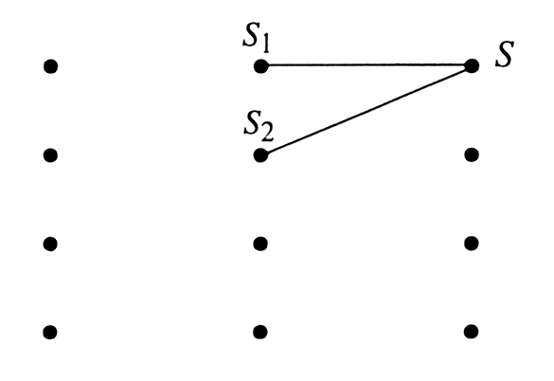
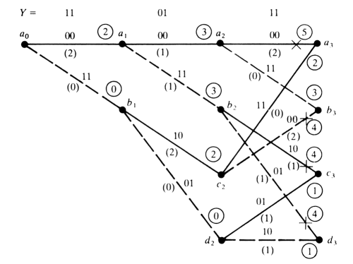




The survivor path
Assume for simplicity a convolutional code with k=1, and thus up to 2^{k} = 2 branches can enter each state in trellis diagram
Assume optimal path passes S. Metric comparison is done by adding the metric of S₁ and S₂ to S. At the survivor path the accumulated metric is naturally smaller (otherwise it could not be the optimum path)
For this reason the non-survived path can
be discarded -> all path alternatives need not
to be further considered
Note that in principle the whole transmitted
sequence must be received before decision.
However, in practice storing of states for
input length of 5L is quite adequate

Slide 23

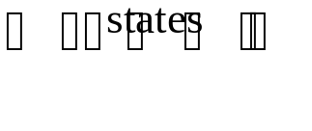
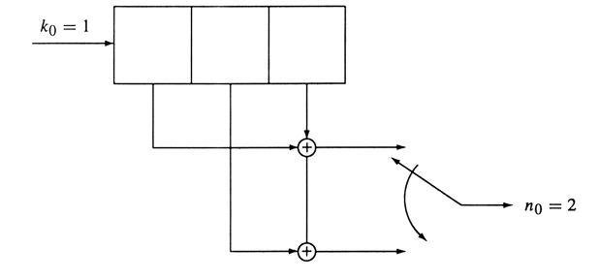
Example of using the Viterbi algorithm
Assume the received sequence is
and the (n,k,L)=(2,1,2) encoder shown below. Determine the Viterbi decoded output sequence!
(Note that for this encoder code rate is 1/2 and memory depth equals L = 2)

Slide 24
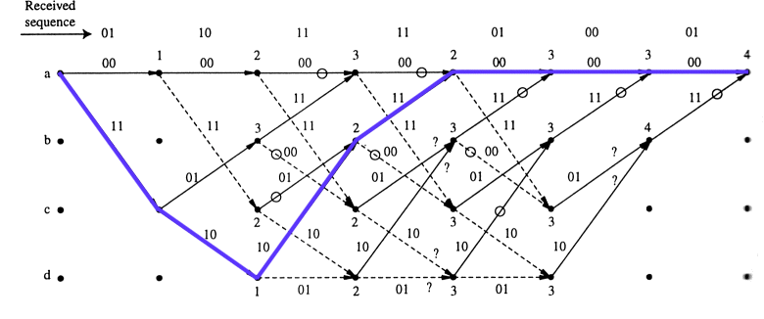



The maximum likelihood path
After register length L+1=3
branch pattern begins to repeat
Smaller accumulated
metric selected
1
1
(Branch Hamming distances
in parenthesis)
First depth with two entries to the node
The decoded ML code sequence is 11 10 10 11 00 00 00 whose Hamming
distance to the received sequence is 4 and the respective decoded
sequence is 1 1 0 0 0 0 0 (why?). Note that this is the minimum distance path.
(Black circles denote the deleted branches, dashed lines: '1' was applied)

Slide 25
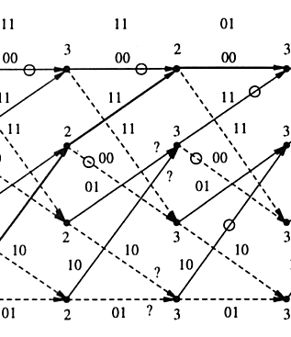

How to end-up decoding?
In the previous example it was assumed that the register was finally filled with zeros thus finding the minimum distance path
In practice with long code words zeroing requires feeding of long sequence of zeros to the end of the message bits: this wastes channel capacity & introduces delay
To avoid this path memory truncation is applied:
  Trace all the surviving paths to the
  depth where they merge
  Figure right shows a common point
  at a memory depth J
  J is a random variable whose applicable
  magnitude shown in the figure (5L)
  has been experimentally tested for
  negligible error rate increase
  Note that this also introduces the
  delay of 5L!

Slide 26
Lessons learned
You understand the differences between cyclic codes and convolutional codes
You can create state diagram for a convolutional encoder
You know how to construct convolutional encoder circuits based on knowing the generator sequences
You can analyze code strengths based on known code generation circuits / state diagrams or generator sequences
You understand how to realize maximum likelihood convolutional decoding by using exhaustive search
You understand the principle of Viterbi decoding

